Slide 1
Data Issues
December 1 2021

Slide 2
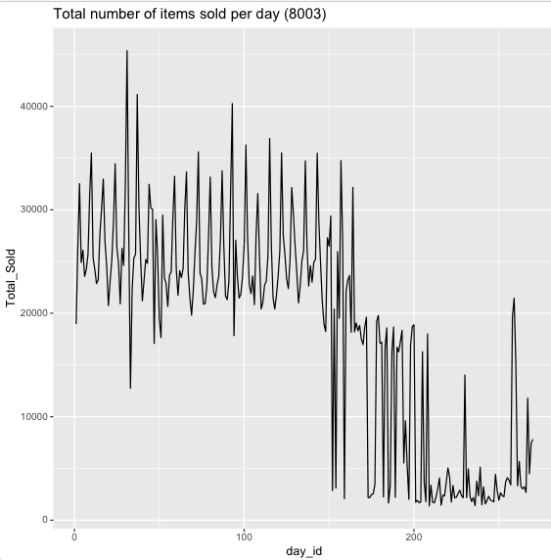
Weirdness in Number of Items Sold per Day

Slide 3
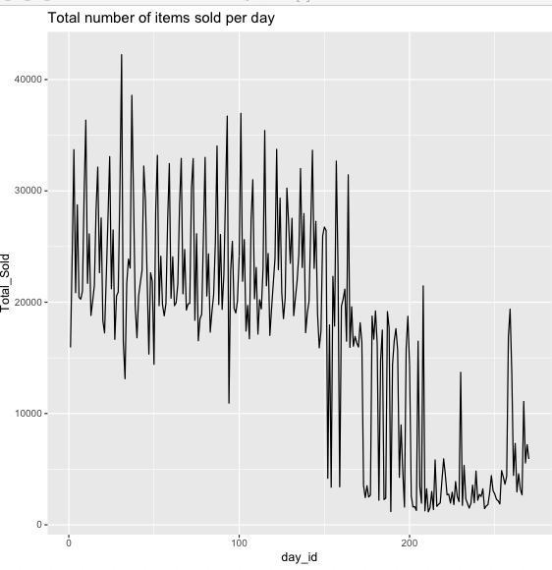
Weirdness in Number of Items Sold per Day

Slide 4
Impact
Massive drop off in daily sales after May 2021.
Leads to lower accuracy on predictions as we train over the first period.
Can improve accuracy and model/optimization performance with correct data.

